Slide 3
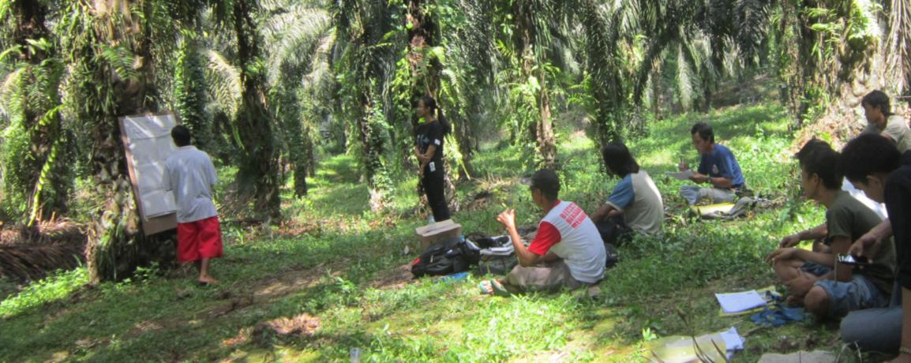
THE SOLIDARIDAD SUSTAINABLE PALM OIL PROGRAMME
Experience working with oil palm farmers in Colombia!
18 October 2018, Fonap General Annual Meeting Berlin

Slide 4
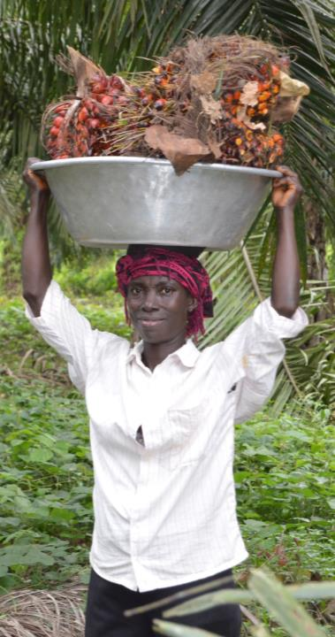
OUR ANALYSIS
Palm Oil valuable crop
Important for global oils and fats supply
High and stable yields: big livelihood potential for rural economies
But production often associated with negative practices
Rather then ban we need sustainable palm oil production & consumption
Reduce negative impacts of oil palm production
increase positive impacts, especially for Small Farmers

Slide 5
FOR SUSTAINABLE PALM OIL WE NEED TRANSITIONS
From | To
Large Scale Investments with workers | Smallholder Supportive Business Models, Tools and approaches
Loss of HCV areas & Indigenous people’s rights | Landscape Level Planning & Programmes
Markets as key sustainability drivers | Governments ensuring responsible development and production & sustainable consumption

Slide 6
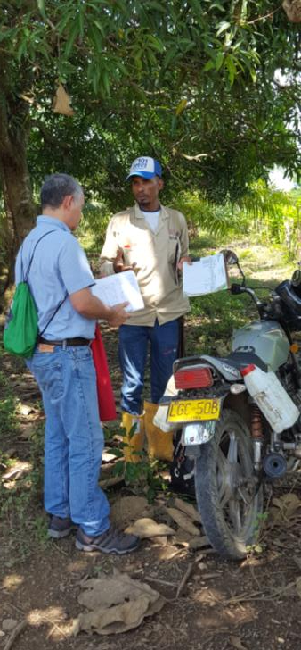
THE ROLE OF SMALLHOLDERS
In most palm oil producing systems smallholders play a dominant role in FFB production
Indonesia 40-50 %
Colombia 14 %
Honduras 80 %
Smallholder production systems – when done right – provide good income potential and allow families to be lifted out of poverty
For a sustainable sector we need to take smallholders along
Notes:
This is an important realisation and ambbition, in particular noting that many of our current certification and assurance ssystems rather work in an exclusive way (as it is more difficult to manage and control risks when many smalllhlders are in a supply base!)

Slide 7
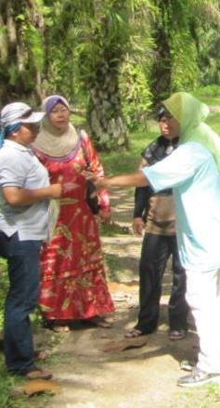
TAKING SMALL- HOLDERS ALONG
Promote Good Practices with farmers –> raising incomes
Using digital tools!
Self-sustaining farmer support hubs
Facilitate economies of scale
Develop and support landscape level initiatives
Create enabling policy environment

Slide 8
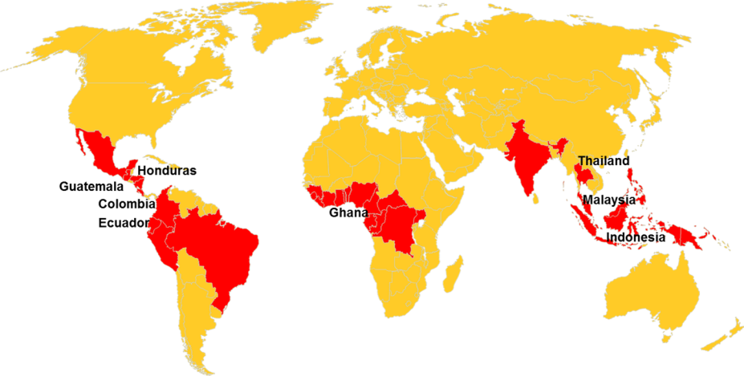
SOLIDARIDAD PALM OIL PROJECTS
PALM OIL PRODUCER COUNTRIES
Europe
United States
China
Mexico
Nigeria
Nicaragua
Ivory Coast
India
Sierra Leone
Liberia
Brazil
PRODUCER COUNTRIES SOLIDARIDAD PROJECTS
Notes:
We also engage with brands and processors in Europe and China.

Slide 9
EXPERIENCE FROM COLOMBIA

Slide 10
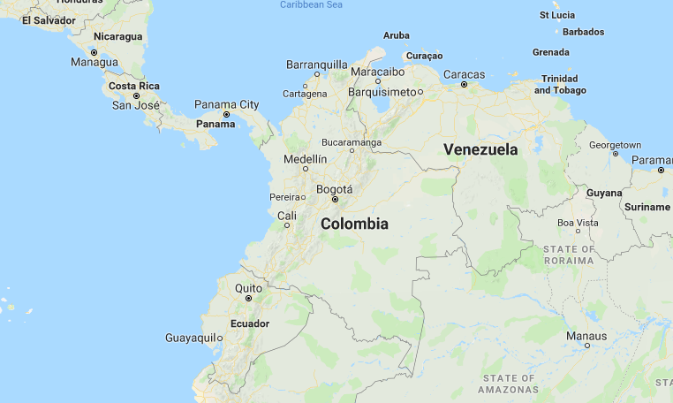
COLOMBIA
Colombia
516.000 Ha of oil palm
4500 small scale growers (84% of total producers )
9 % of Colombia GDP
Palm Considered the peace crop; 70.000 direct jobs; Compensation levels 20 % higher than in other agric sectors !

Slide 11
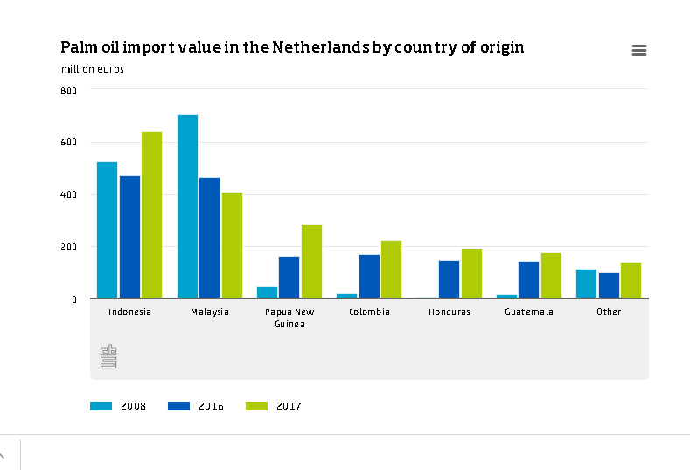
Source: Centraal Bureau Statistiek, website consulted 15 October 2018

Slide 12
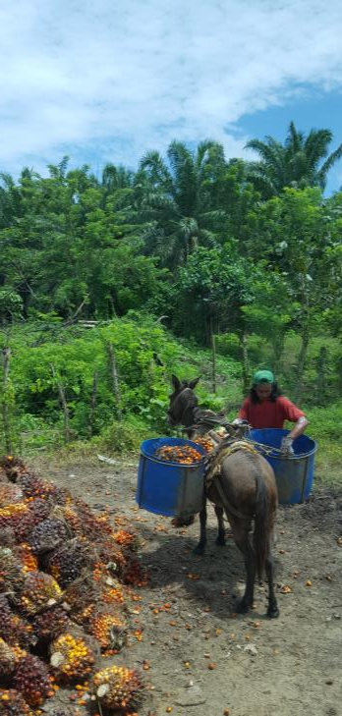
PALM OIL IN COLOMBIA
2018:
11 companies are RSPO Certified (3 Rainforest Alliance Certified, 5 ISCC Certified)
23 are in process.
The ambition of the sector:
2020: 50% of Colombian CPO production certified
2025: 75% of Colombian CPO production certified
Further expansion potential of 5 million ha, without deforestation

Slide 13
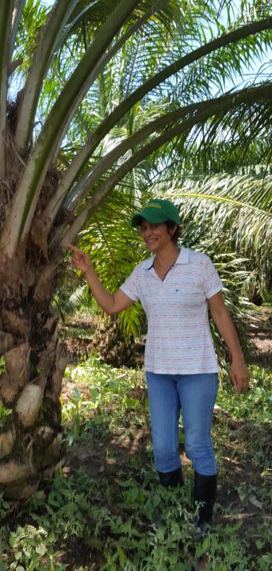
SOLIDARIDAD PALM PROGRAMME IN COLOMBIA
2011 Single project with Oleoflores
2013-2016 FSP project support 5 companies with implementation RSPO
2014 Sustainable Trade Platform
2017- Zero deforestation commitment Colombian Palm Oil producers
Smallholder inclusion & support using Digitalisation

Slide 14
THE FARMING SOLUTION TOOL
Goal: Improve livelihood and sustainability performance of oil palm smallholders
Objective: Create, Pilot and Scale Up digital tool to facilitate farmer extension
Functionalities
Diagnosis tool facilitating self assessment
Decision support tool to facilitate development of work plan
Provide continuous improvement methodology

Slide 15
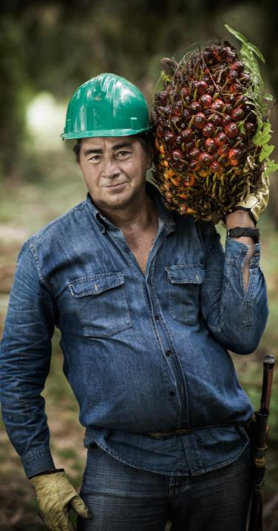
PARTNERS
Henkel supports for 3 years (2018-2021)
Focus group: 650 smallholders (250 in Tumaco and 400 in Central North of Colombia)

Slide 16
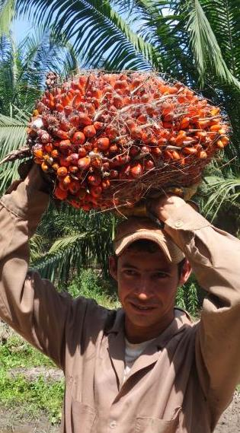
PARTNERS
Fedepalma found the Henkel project as an opportunity for the first step of their national sustainability strategy
With Fedepalma Solidaridad will implement
Farming Solution + Extension Solution
Extensionists of the mills verify, assist and teach. Extesionists of Cenipalma (Colombian Research Center for Palm Oil) complement with their knowledge
Pilot with 130 smallholders in 2018 (all 4 palm oil regions in Colombia),
At least 1.700 smallholders in 2019 (650 of Henkel´s project + 1.050),
Scale up to all 5.000 small scale and medium growers in 2020.

Slide 17
STEPWISE APPPROACH
Farming & Extension Solution (Scale up: Mid 2019 – 1.700 producers)
Farming & Extension Solution (Test: Nov 2018 – 130 producers)
Farming & Extension Solution (Scale up: Mid 2020 – 5.000 producers)

Slide 18
EXPECTED RESULTS 2020
Baseline of sustainability status of all smallholders in Colombia (low, medium or high performance) to know and show how sustainable they are.
Risk level status to focus on the highest risks and mitigate them
Clear cost/investment needs to close the gaps (fundraising or bank loans)
Data Collection and Analysis. All in one monitoring and evaluation system
Continuous improvement tool for the long term (never stop learning and improving)

Slide 19
RSPO SMALLHOLDER ENGAGEMENT PLATFORM
https://www.rsep.rspo.org/index.php

Slide 20
SMALLHOLDER EMPOWERMENT PLATFORM
Developed as part of RSPO Smallholder Strategy
Objectives & Benefits
Increase Visibility Oil Palm Smallholder Initiatives Worldwide
Provide Matchmaking Smallholders with Market partners
Knowledge sharing existing projects
Enhance development tailor made models

Slide 21
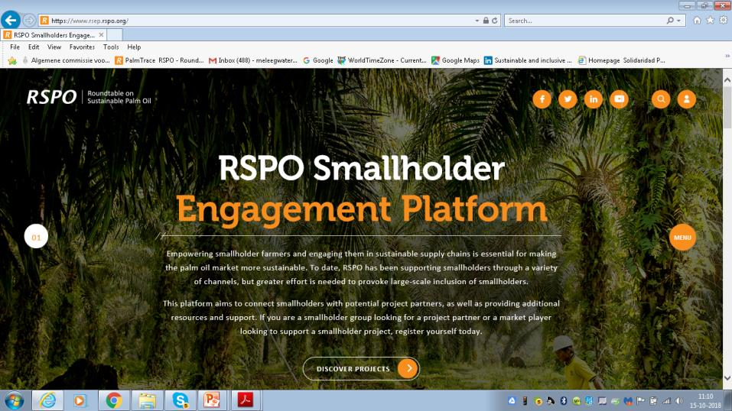
HOME

Slide 22
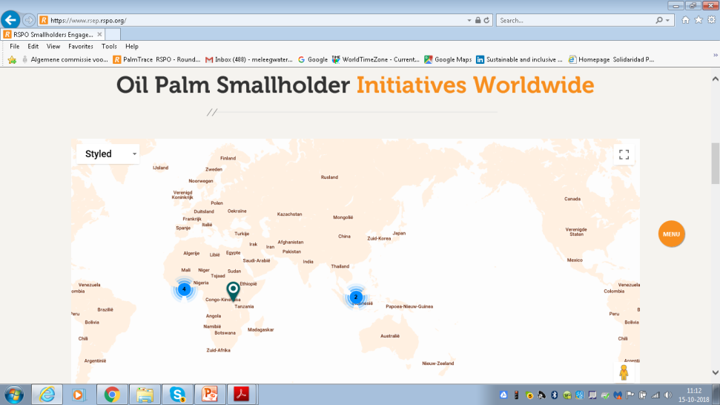
MAP

Slide 23
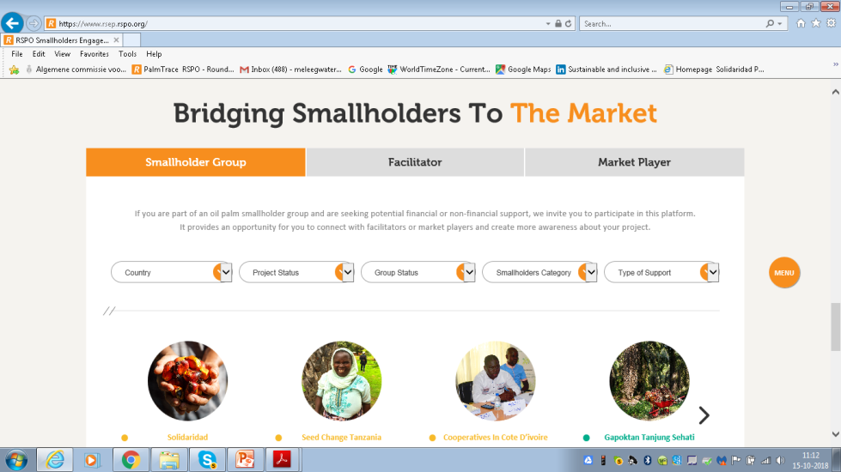
MATCH MAKING

Slide 24
Thank you!
Marieke.leegwater@solidaridadnetwork.org

