Slide 1
RSPO P&C Review Process
FONAP, Berlin
Sept 2017
PREPARED BY:
Bilge Daldeniz, Proforest
27 Sept 2017

Slide 2
Background
ISEAL Standard Setting Code calls for a review of the standard every 5 years
Current P&Cs in vigour since 2013 (first P&Cs 2005; 2 year trial till 2007)
Key elements of RSPO SOP for Standard Setting & ToR for Standard Setting Process as approved by Board of Governors in Feb 2017:
Steering Group
P&C Review Taskforce composed of 24 substantive members
Estimated 4 Taskforce meetings
2 public consultation periods incl. physical consultation workshops
Facilitation team:
Proforest: overall technical facilitation of entire process incl. public consultation phases by Proforest
Daemeter: facilitation of Taskforce meetings
RSPO Secretariat: technical team supporting the facilitators
Notes:
SOP – Standard Operating Procedure
ToR – Terms of Reference

Slide 3
Key Roles
Steering Group has oversight of process & called upon to resolve deadlock situations in the TF
Composed of:
members of Standard & Certification Standing Committee
Chair of Communications & Claims Standing Committee
Chair of Trade & Traceability Standing Committee
RSPO Technical Director
& joined by Chair of P&C Review Taskforce & Co-Chair of SHWG in informant/non-voting capacities
P&C Review Taskforce (TF) composed of 24 substantive members (& 24 alternates):
3 Smallholder/Outgrower representatives
3 Rest of the World growers
3 Social NGO
6 SCC actors incl. banks/investors
All TF members are listed on the dedicated subsite for the P&C Review:
http://www.rspo.org/principles-and-criteria-review
3 Indonesian growers
3 Malaysian growers
3 Environmental NGO
Contact form
Notes:
SCC – Supply Chain Certification this includes Traders & Processors, Consumer Goods Manufacturers, Retailers
Here you should highlight that engaging with their taskforce reps is another way to be engaged in the P&C Review aside from providing comments via public consultation. The different sectors have their own mechanisms of liaison. They can get in touch via the contact form [see next slide] and find out how their sector communicates.

Slide 4
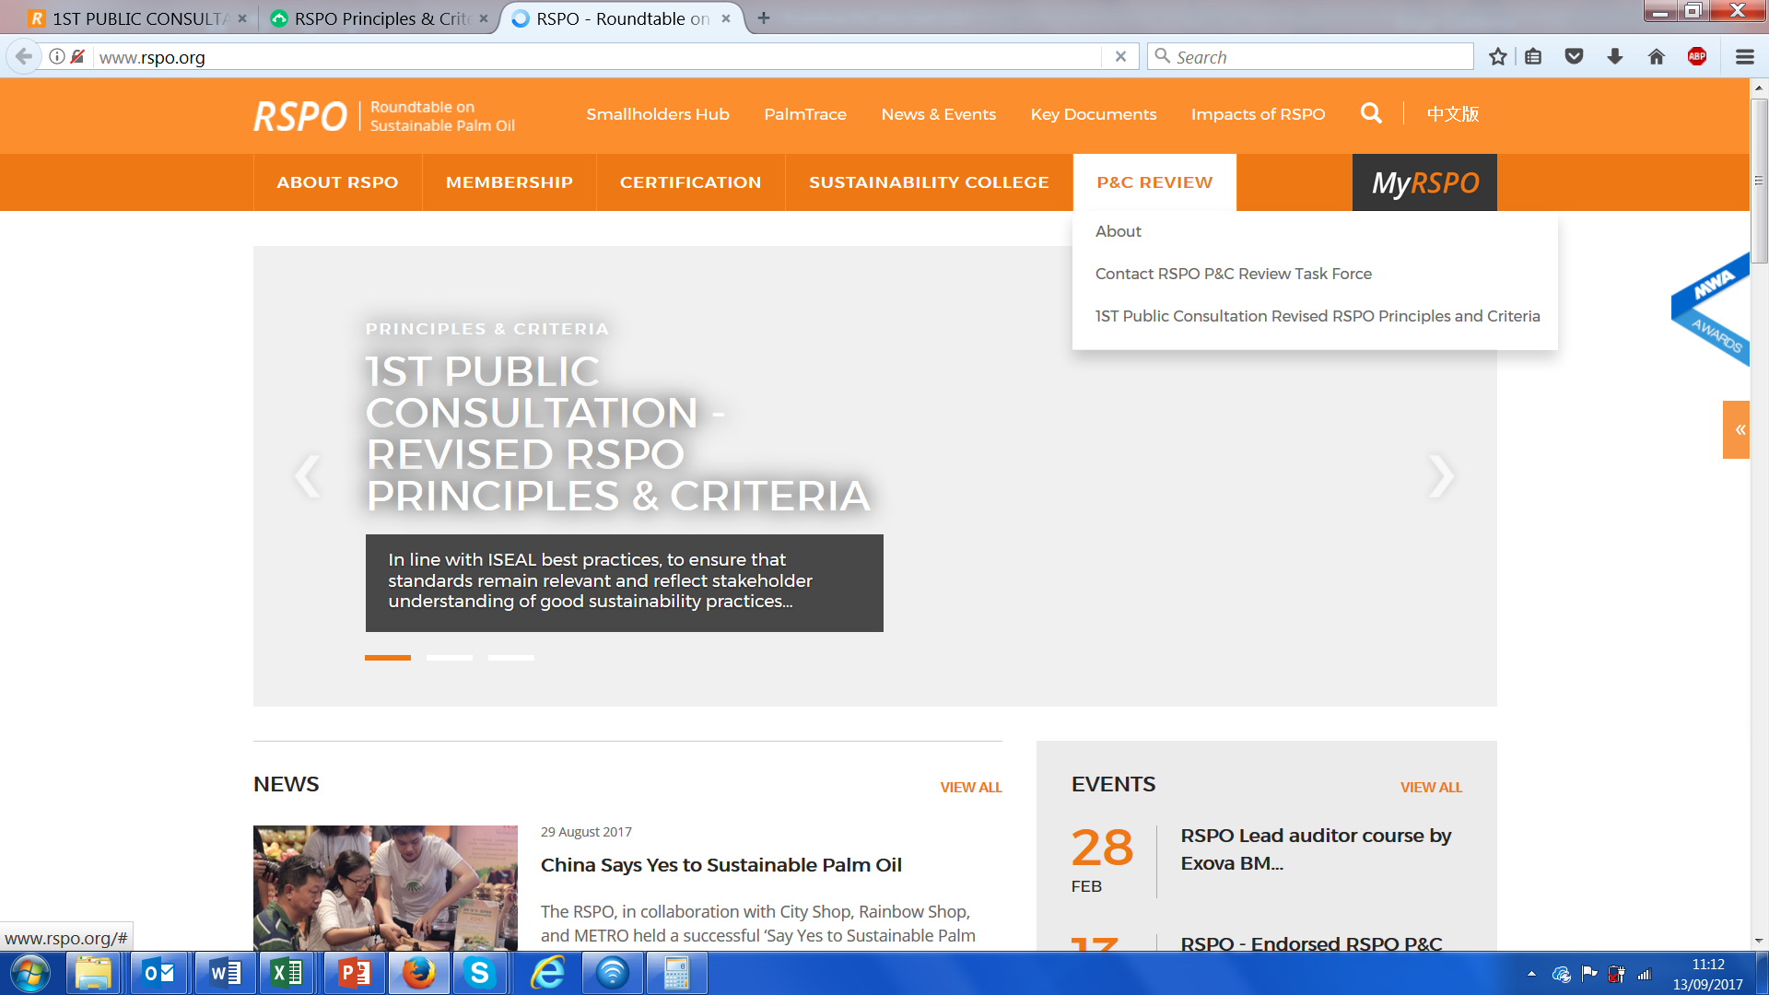
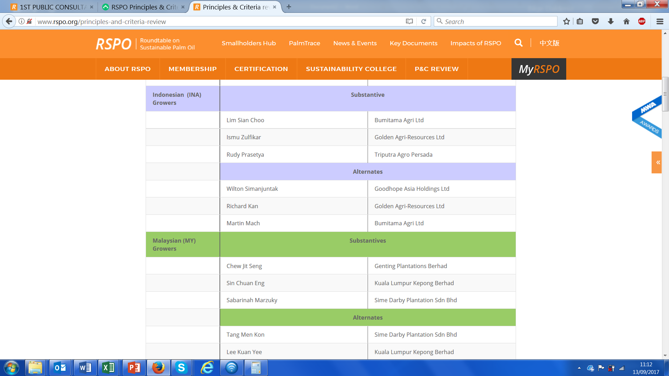
Notes:
These screenshots come in one after the other, so make sure you check these on ‘presentation mode’ so you know the order ☺

Slide 5
Timeline
SG Briefing 1
telcon
SG Briefing 2
EURT
SG Briefing 3
telcon
SG Briefing 4
RT
SG Briefing 5
telcon
April 2017
May 2017
July 2017
Sept/Oct 2017
Nov 2017
Feb 2018
March 2018
May 2018
June 2018
Nov 2018
TF establishment
Proforest Preparatory Report
First TF Meeting in KL
Draft 1 at 2nd TF Meeting in Jakarta
1st Public consultation incl. workshops
Comments collation and analysis TF3 in Bali
2nd Public consultation incl. workshops
Comments collation and analysis at TF4 in KL
Field testing and final draft submitted by TF to SG
Final draft submitted to BoG for endorsement
New P&C voted in at 2018 GA
Draft 1 & ‘SH Considerations’
Notes:
SG – Steering Group
TF – Taskforce
EURT = RSPO roundtable event in Europe
RT = RSPO roundtable event once a year
BoG= Board of Governors
GA = General Assembly

Slide 6
1st Public Consultation
60 day period: 01.09.-30.10.
Materials:
P&C draft 1 & online survey
Considerations for Smallholders as comment template
3. Face-to-face consultation events:
Public consultation workshops
SH focused workshops in combo with SH NPP Guidance
Outreach/Roadshow event to reach newer stakeholders
http://www.rspo.org/principles-and-criteria-review/1st-public-consultation-revised-rspo-principles-and-criteria

Slide 7
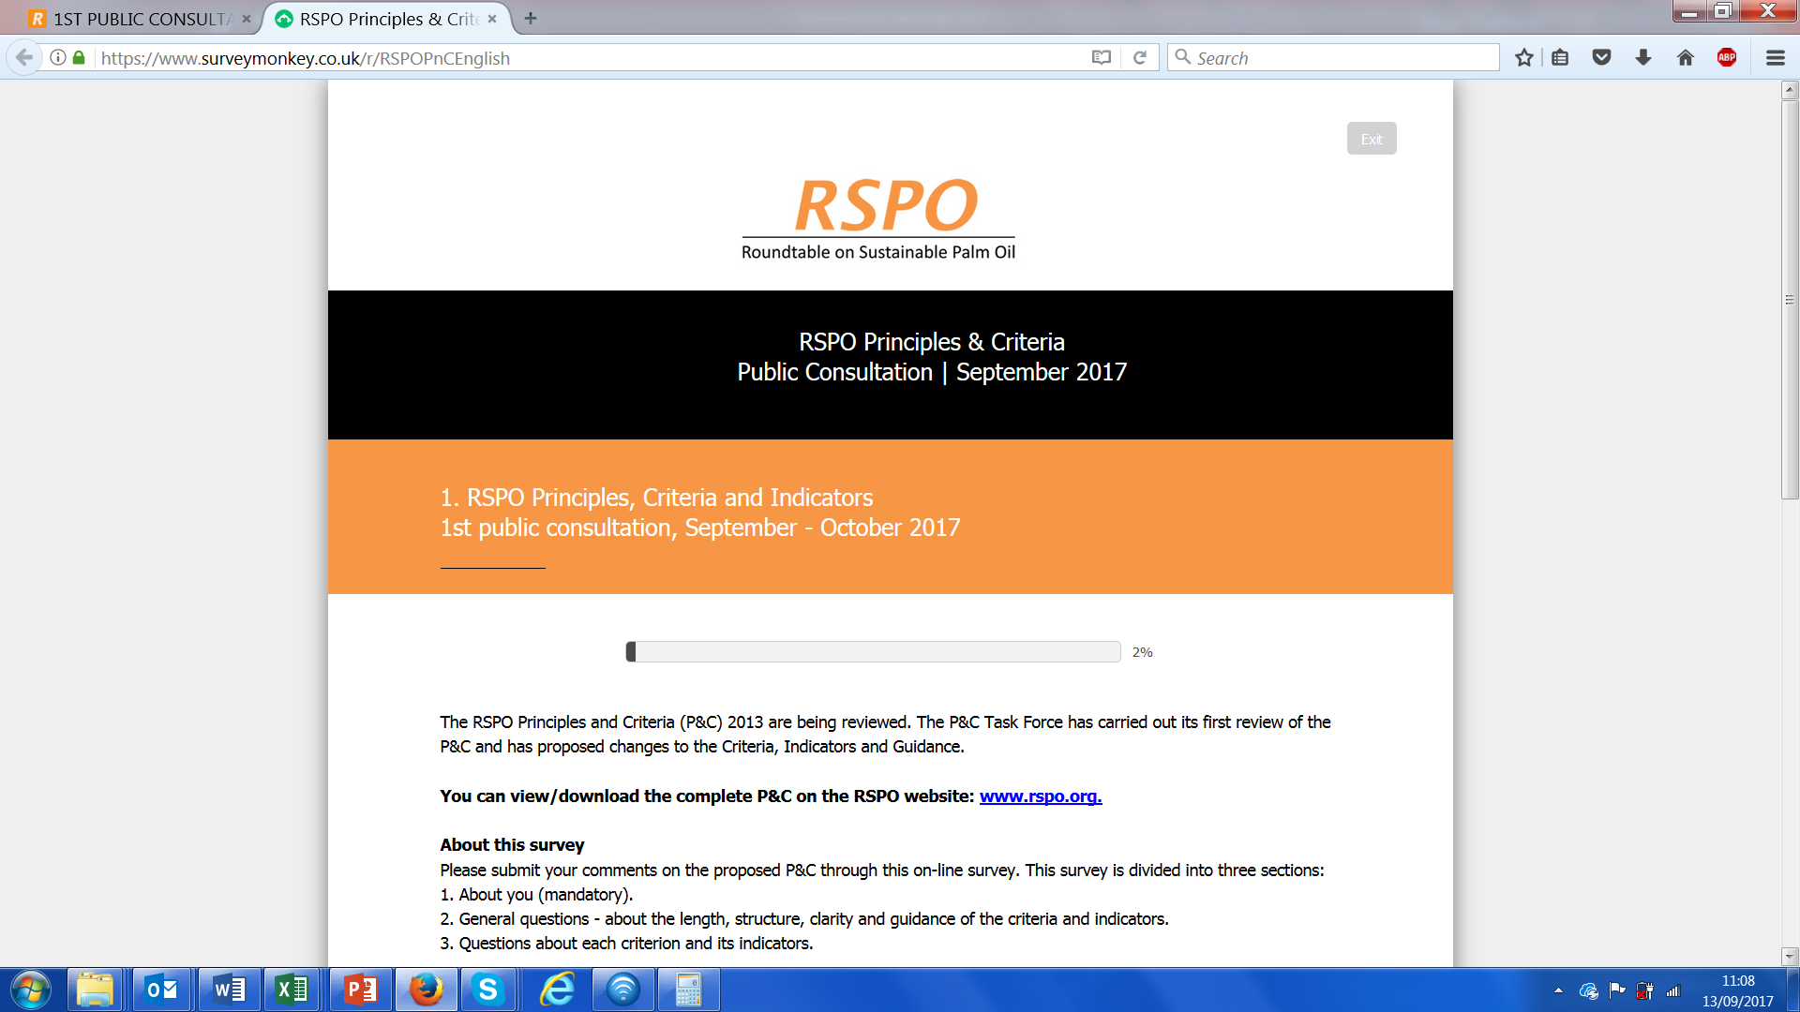
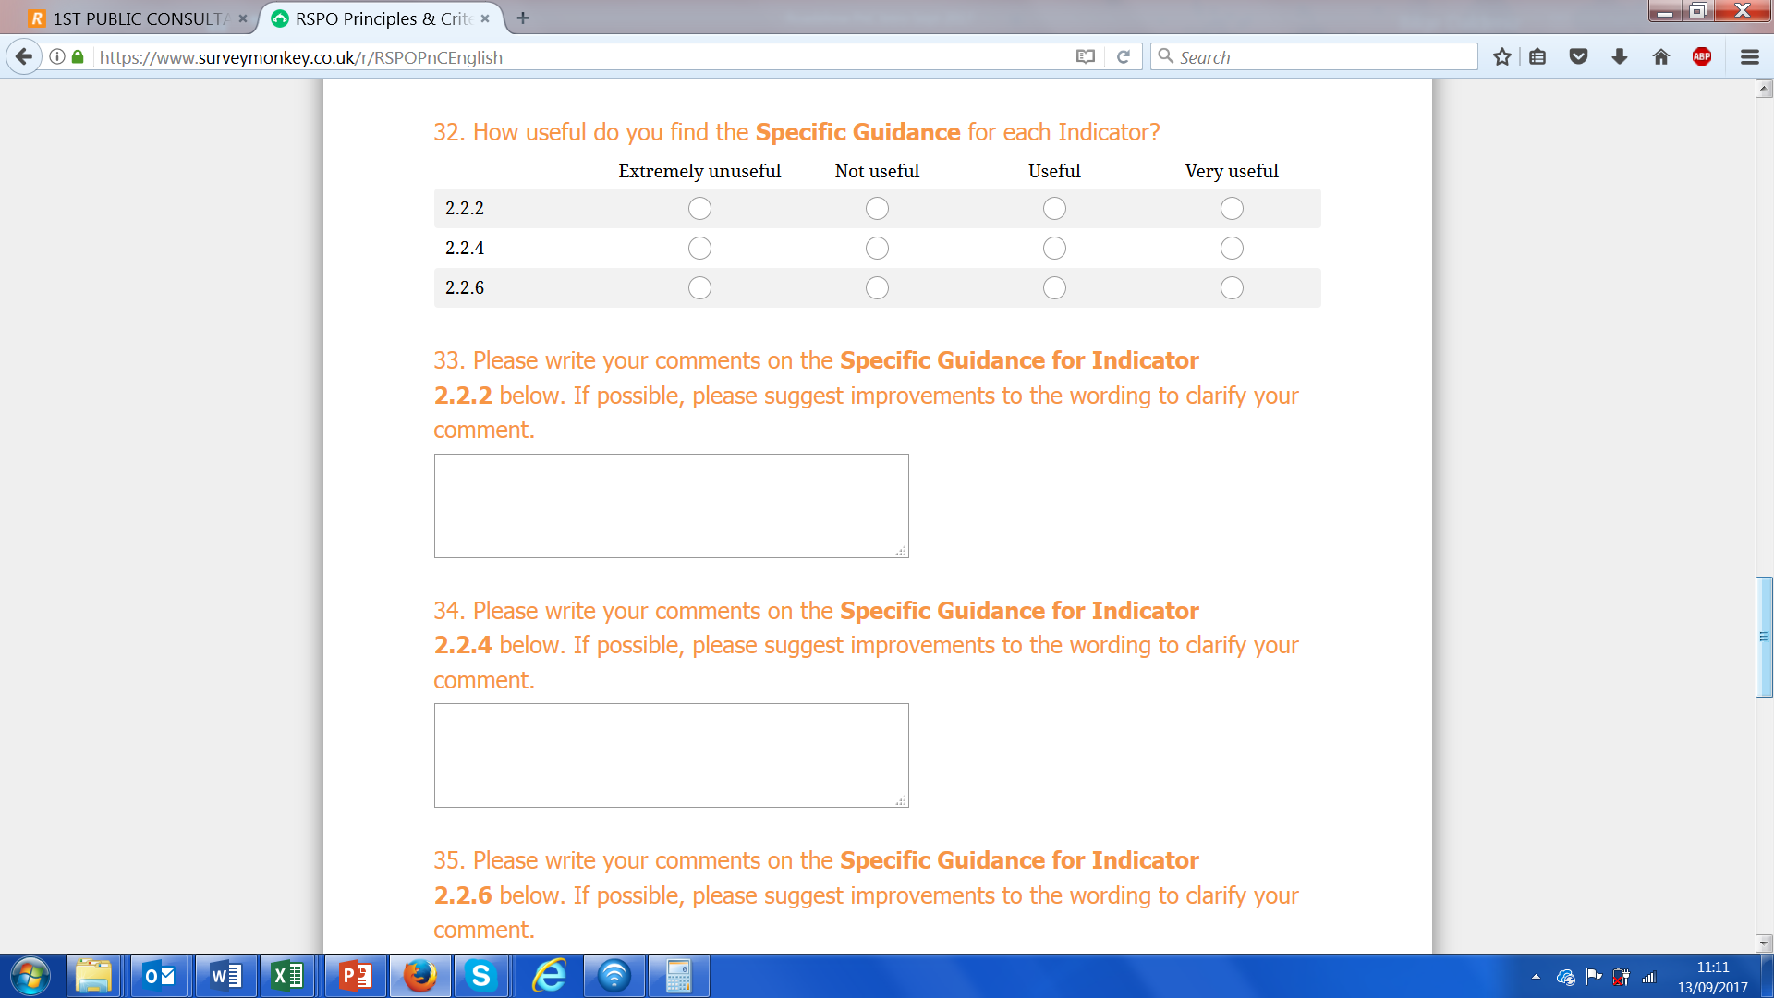
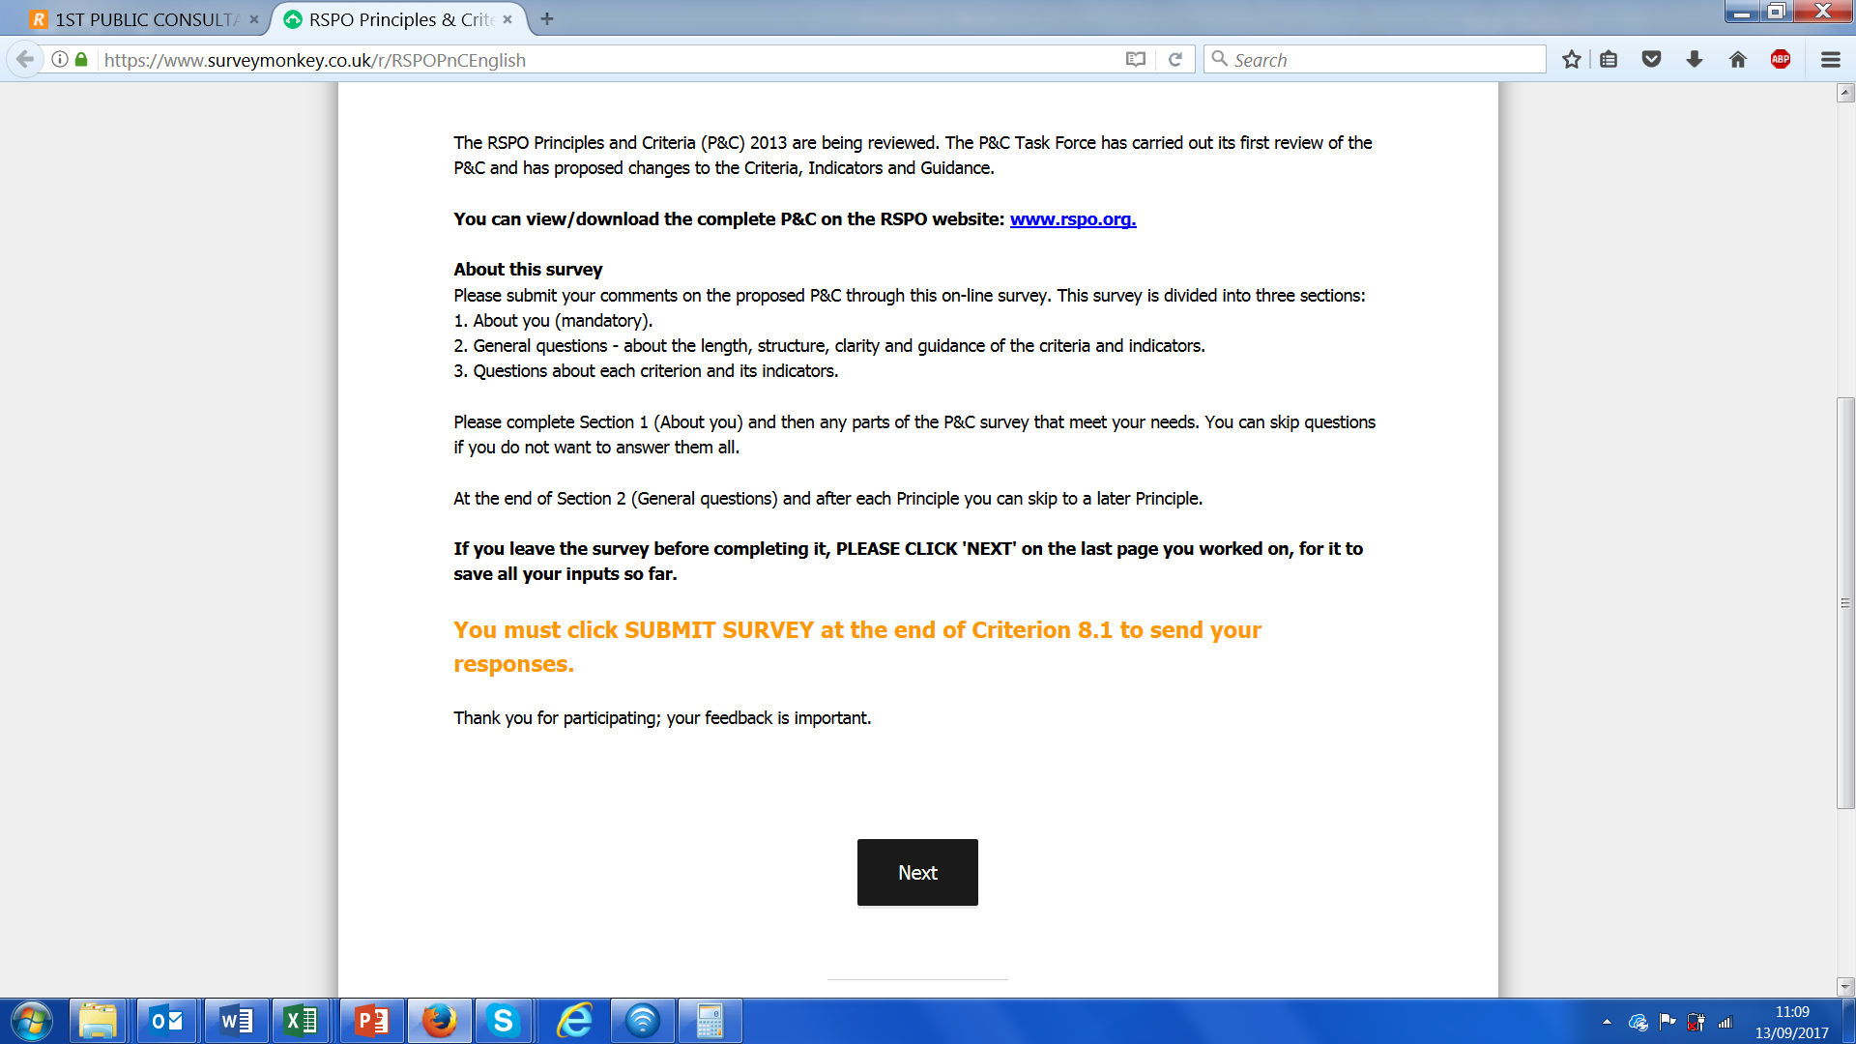
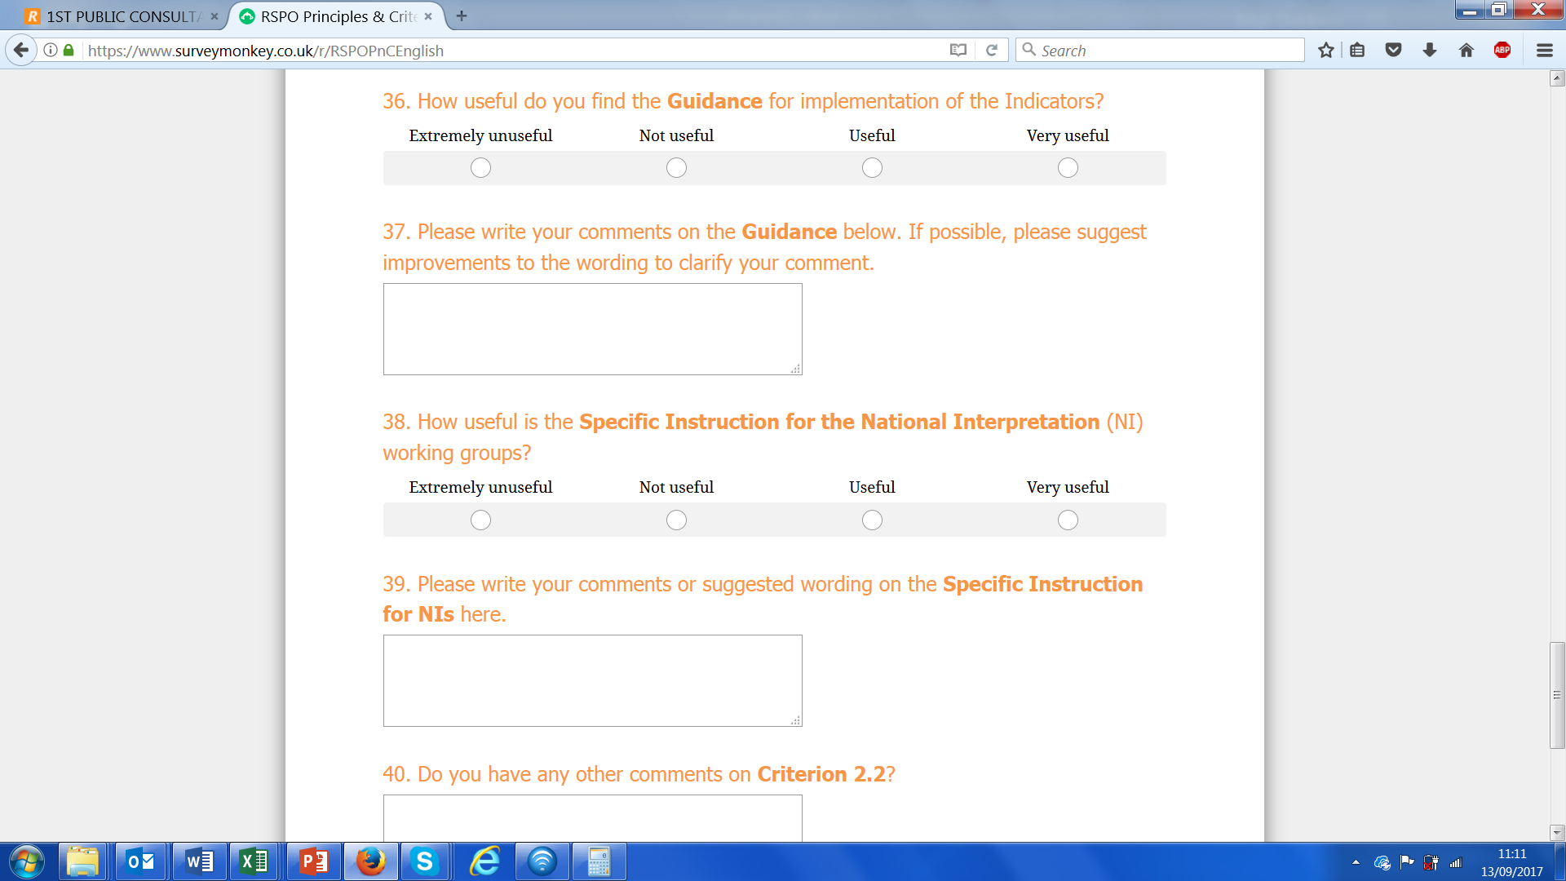
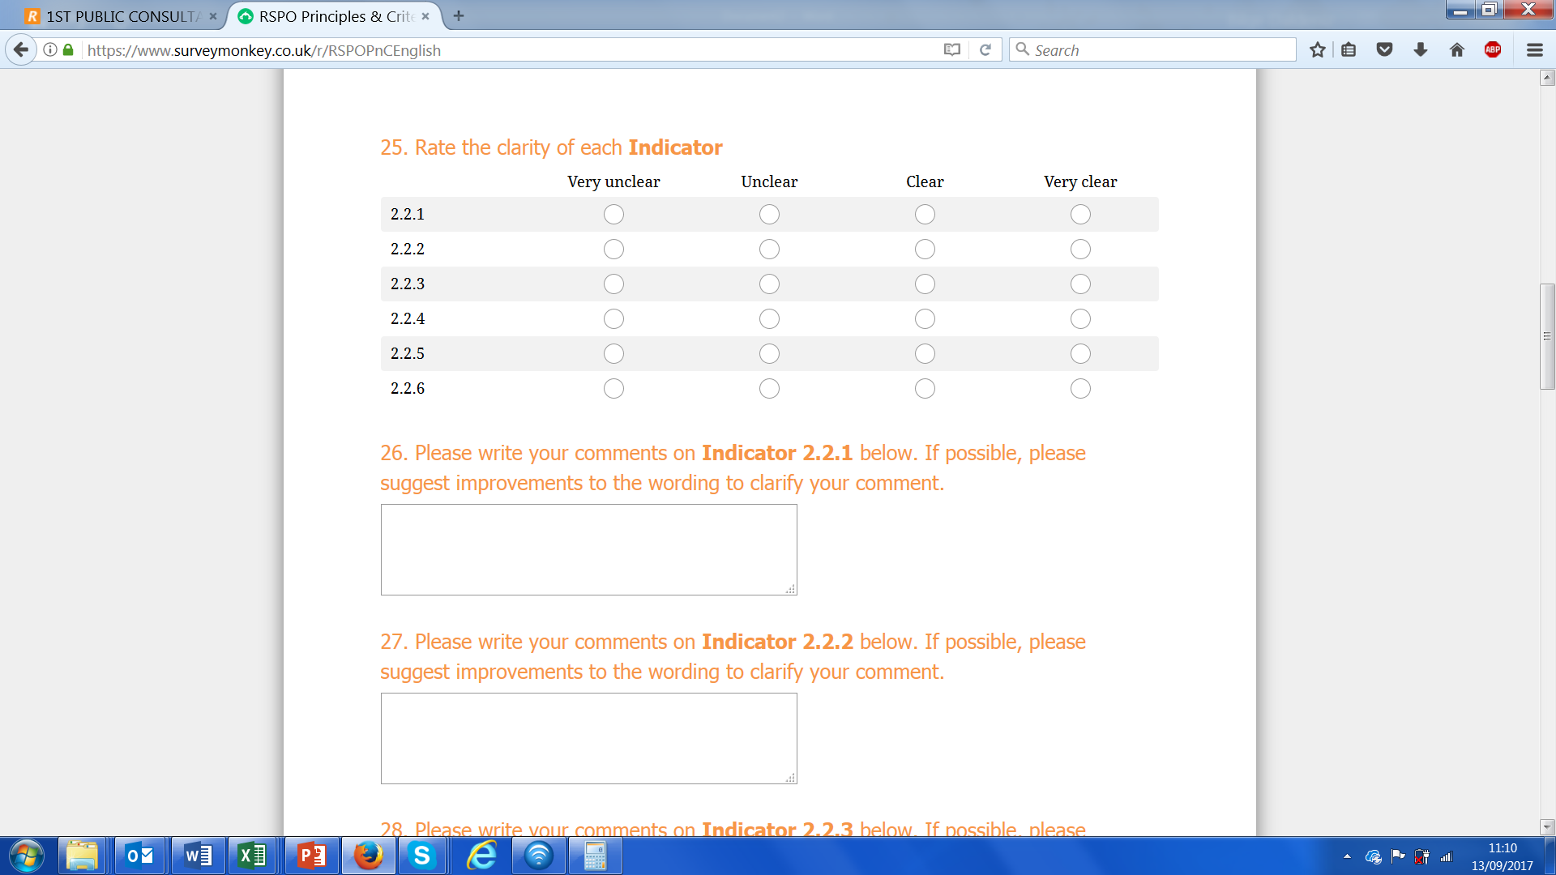
Notes:
Screenshots come in one after the other, so please check in ‘presentation mode’ so you know the order.
Point out that you need to answer the first two sections, but then you can jump ahead at the end of each principle. Remind them to click on ‘next’ to make sure their work is saved, and when they are ready to submit it to us, to go to the last page (C8.1) and hit ‘submit’.

Slide 8
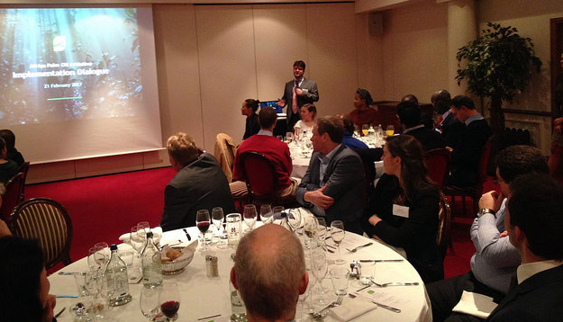
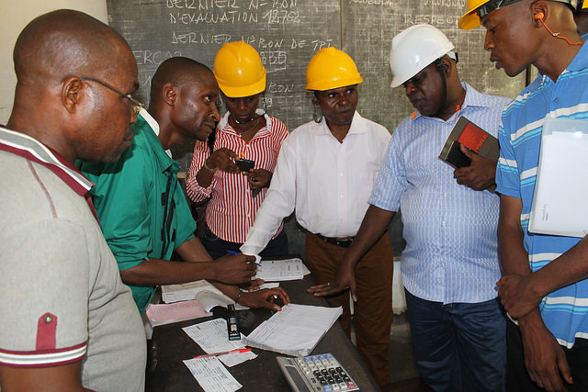
Public Consultation Workshops
Phase I (est. Sept/Oct 2017) – 60 days
PHASE II (Est. Q1 2018) – 30 DAYS
Phase I Roadshow Events
Europe workshop (in English)
Malaysia workshop (in English)& SH event (in Malay)
Indonesia workshop & SH event (in Indonesian)
Thailand workshop & SH event (in Thai)
Africa workshop & SH event (tbc. English or French)
LatAm workshop & SH event (in Spanish)
Online webinar in Portuguese
NYC Roadshow (in English)
Berlin Roadshow (in German)
Brussels Roadshow (in English)
Paris Roadshow (in French)
Stockholm Roadshow (in Swedish)
China Roadshow (in Mandarin)

Slide 9
Next Steps
Analysis of comments received
Comments to be discussed at TF 3: 22-24th Nov, Bali
Draft 2 to be developed
2nd Public Consultation: 30 days, Q1 2018

Slide 10
Draft 1 – Key Changes
TF so far only looked at content of P&C
Aspects such as structure, simplification, metrication, etc yet to be discussed
Separate TF subgroups working on ‘no-deforestation’ and ‘smallholders’

Slide 11
MAIN TOPICS
Workforce
Work terms and conditions: decent living wage, documentation, family labour, conditions [6.5]
Labour rights: freedom of association [6.6]and non-discrimination [6.8]
Exploitation of labour: prohibition of child labour [6.7] and forced labour [6.12]
Environment
No deforestation [pre 7.3]
HCV: management plan at landscape level [5.2], RaCP, management and assessment tailored to scale; simplified approach below X ha [7.3].
Soils: No new planting on peat [7.4b]; protect soils; manage existing plantations on peat responsibly [4.3a&b].
Pesticides: No use of WHO listed chemicals or paraquat [4.6]
Community and legality
Planting on local people’s land: FPIC and local food security [7.5]
Right to use the land [2.2]
Legality of 3rd party Fresh Fruit Bunches (FFB) [4.1]
Grievances, complaints [6.3] and human rights defenders [6.13]
Notes:
EXTRA AREA IF THERE’S TIME
Fire: No use of fire for land prep [7.7]; prevention and control [5.5]

Slide 12
THANK YOU
www.rspo.org
www.proforest.net
27 Sept 2017

