Slide 1
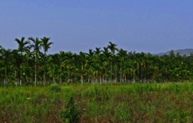
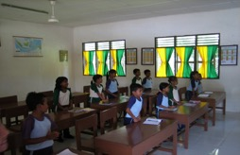
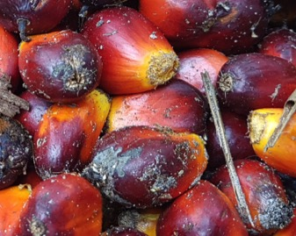
How to improve Social Criteria within a Certification System
FONAP General Assembly, Berlin, 27 September 2017
R. Vasu Vasuthewan, Juliane Pohl, ISCC System GmbH
Notes:
1
1

Slide 2
Content
1
Introduction
2
Example 1: Social Issues
3
Example 2: Food Security

Slide 3
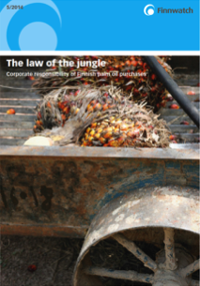
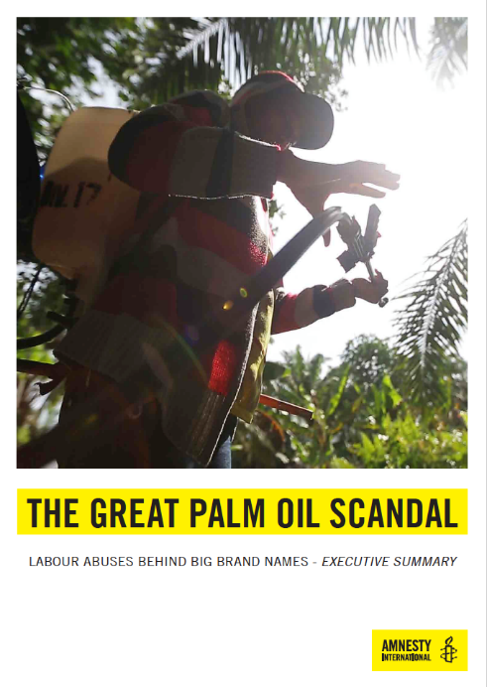
ISCC is focusing on social issues. Continuous dialogue with stakeholders and further development of standard
Examples
ISCC takes such reports seriously
Continuous development of standard
Stakeholder dialogue
Dialogue with the NGOs, e.g. Finnwatch (social issues), Welthungerhilfe (food security) and others
Working group “Social Issues” in the framework of the ISCC Technical Committee Southeast Asia
ISCC Integrity Audits
Coverage of topics in ISCC trainings for auditors and company representatives

Slide 4
Content
1
Introduction
2
Example 1: Social Issues
3
Example 2: Food Security

Slide 5
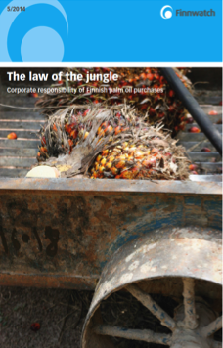
Finnwatch report „The law of the jungle“ – Findings of the NGO
Report “The law of the jungle – Corporate responsibility of Finnish palm oil producer” was published in September 2014 by Finnwatch
Finnwatch is a Finnish NGO that focuses on business actions in developing countries
Report contains allegations of breach of social standards at four IOI plantations in Malaysia that were covered by ISCC and RSPO certificates
Finnwatch visited three of the plantations on-site. Information on the fourth planation were gathered by interviews with workers conducted outside the plantation
The findings mostly focused on social standards for migrant workers:
High recruitment costs for foreign workers
Working contracts not available in appropriate languages
No payment of minimum wage to foreign workers
Restrictions of freedom of association of foreign workers
Withholding of identity papers of foreign workers

Slide 6
Finnwatch report and immediate actions taken by ISCC
Meeting of the stakeholder group SEA in Bangkok with participation of Finnwatch
ISCC sends independent auditor to three plantations in MY to check Finnwatch allegations
ISCC publishes 2nd ISCC statement
3 Sept ‘14
11/12 Sept ‘14
16 Sept ‘14
2 Dec ‘14
13 March ‘15
24 March ‘15
12 Aug ‘15
ISCC learned about Finnwatch investigations and allegations
Finnwatch published report and ISCC published 1st statement on the report
Finnwatch published follow up report with responses by certification schemes and company
Set up of the working group “Social Issues” during meeting of the stakeholder group SEA in Jakarta

Slide 7
Overview: ISCC has reacted quickly and implemented open issues stated in the Finnwatch report
2014
2015/2016
2016/2017
Retention of passports Discrimination of foreign workers Freedom of association Minimum wage Recruitment cost Contracts in appropriate languages
Development of requirements and implementation
Implementation and further improvement
= Analysis
= Fully implemented
= Not to be influenced by ISCC/ out of scope
= Measures developed
= Partially implemented

Slide 8
Content
1
Introduction
2
Example 1: Social Issues
3
Example 2: Food Security

Slide 9
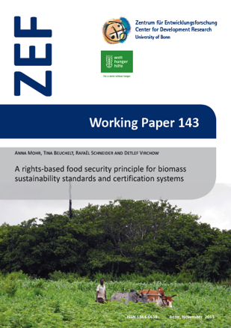
Food security – Specific and verifiable criteria have to be developed and implemented (I)
Issue: Food security is of growing importance but hardly or only insufficiently covered by certification standards
Current coverage under ISCC: “Is it ensured that biomass production does not impair food security”*
Specific and verifiable criteria should be developed and implemented
In 2014 ISCC contributed to a project of the Center for Development (ZEF) and Welthungerhilfe
Research on rights-based food security principle for biomass sustainability standards and certification systems
Development of criteria and checklists to cover food security for sustainability certification
Field testing phase required
* Requirement 7.1.64 (minor must), ISCC System Document 202 v3.0

Slide 10
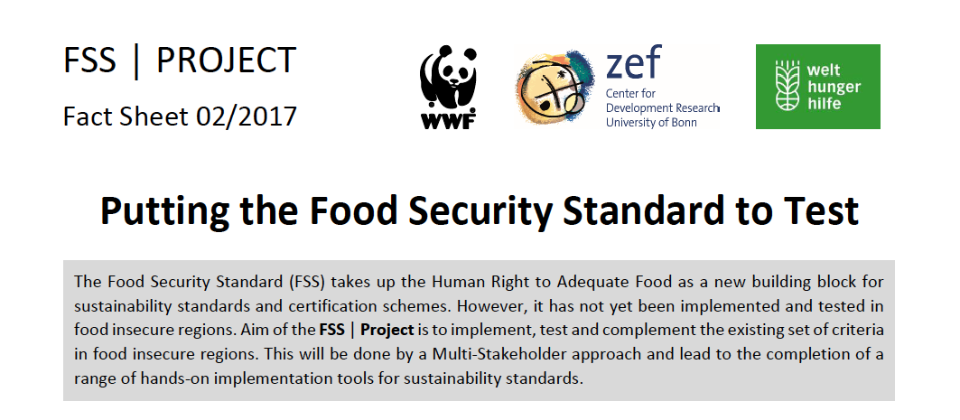
Food security – Specific and verifiable criteria have to be developed and implemented (II)
2017: ISCC is partner of FSS Project by WWF, ZEF and Welthungerhilfe
Follow up project of the study of food security principles for biomass certification
Objectives:
Implementation, testing and complementation of food security criteria
Field testing phase in food insecure regions
Pilot audits planned in Bolivia and Guatemala (conducted with ISCC)
Results from this project could be implemented in ISCC certification standard

Slide 11
Many thanks for your attention!
Contact
R. Vasu Vasuthewan Juliane Pohl ISCC System GmbH Hohenzollernring 72
D-50672 Cologne, Germany
Email: vasu.board@iscc-system.org pohl@iscc-system.org
Notes:
11
11

