Slide 1
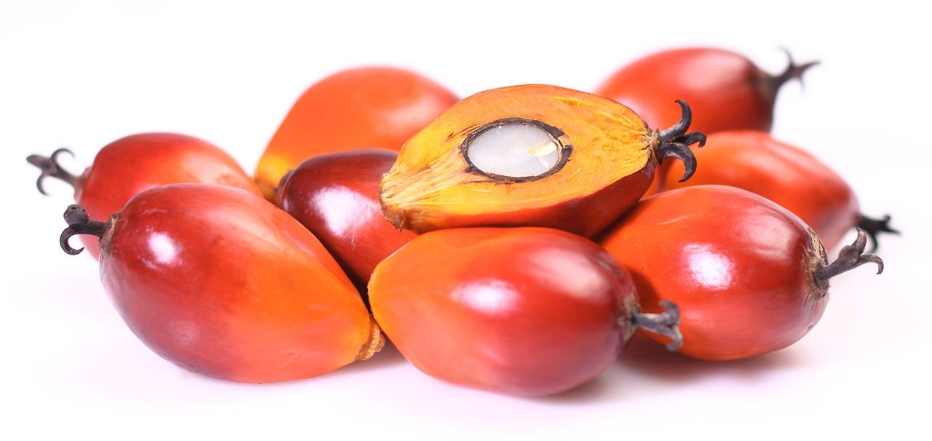
General Assembly of the German Forum on Sustainable Palm Oil – September 27, 2017
The Perception of Palm Oil in Europe
Source: Kevron Global
Presented by Kristjan Jespersen
Copenhagen Business School, Denmark

Slide 2
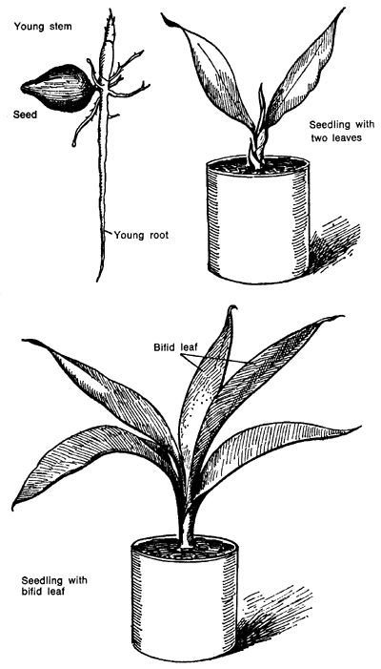
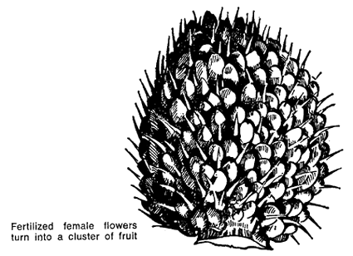
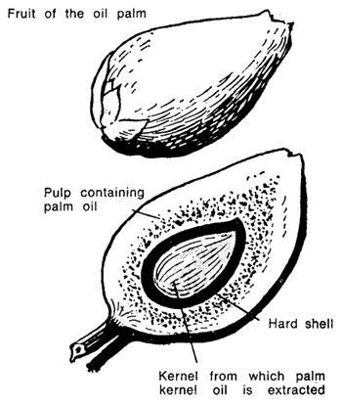
Introduction
Kristjan Jespersen, PhD
Copenhagen Business School, Denmark
Primary research focus:
Focused on Impact Research
Global commodities
Ecological economics
Corporate sustainability
Source: FAO – Modern palm oil cultivation

Slide 3
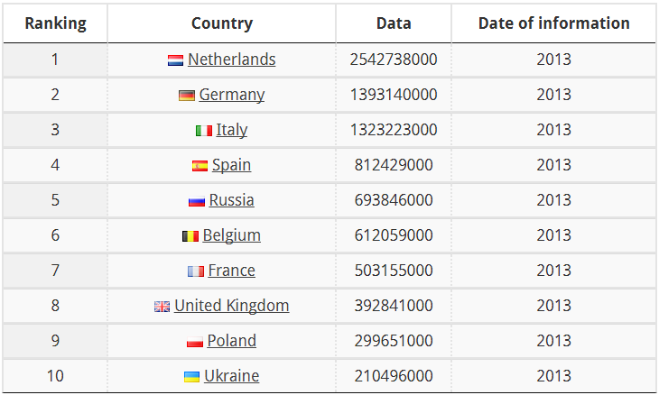
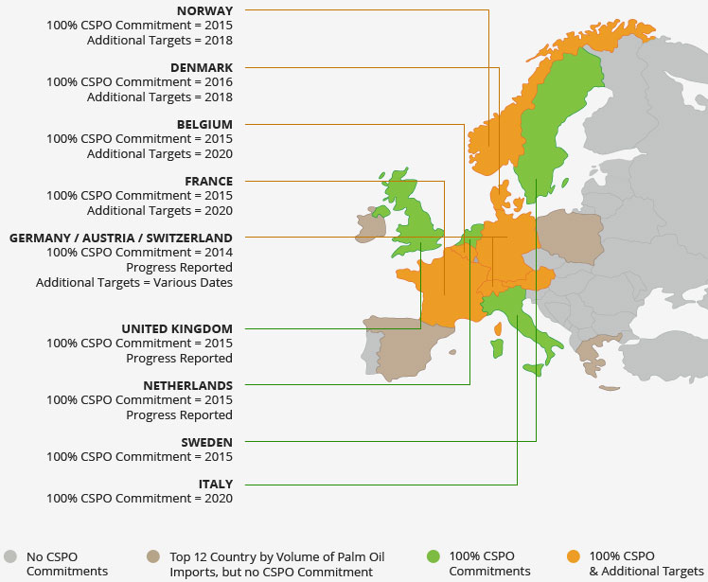
Research project – method
European national commitments to sustainable palm oil
Factiva search for keyword: ‘palm oil’ in different languages
51.727 news articles in 14 countries
Interviews with industry experts regarding policy and market environment for palm oil
Source: Actualitix – Europe, Palm Oil Import
Source: www.rspo.org/certification/national-commitments
Notes:
Research project studying the European national responses to the RSPO
National Commitments refer to country-level initiatives, spearheaded by industry, government, or both, to forge alliances towards Certified Sustainable Palm Oil commitments.
We seek to understand why countries have different levels of commitment – i.e. why do some countries go above and beyond while others have no country-level initiatives?
News articles:
Comparing the number of articles in the different years allow us to illustrate how the interest in palm oil has developed over time in the each country.
Furthermore, we can compare the number of articles for each country to see the different levels of engagement from national media.
We have coded the articles in different themes to understand how the debate has evolved over time – is it driven by different issues in different countries?
Interviews:
Gather perspectives from national government leaders, civil society actors, firms, and trade associations in order to understand the interests and concerns of all parties in the European palm oil supply chain.
The questions focus on the policy and market environment for certified sustainable palm oil in your country.

Slide 4
Preliminary findings
Notes:
The number of articles published each year generally starts to increase from 2005/2006 across the whole sample, although some countries see a larger increase
Interesting that the increase coincides with formation of the RSPO 1-2 years prior (change happens across Europe at large, not single countries)
However, there is no apparent connection between the number of articles and whether a country has a national commitment or not → therefore we need to look at the details, i.e. what is in the articles

Slide 5
Germany
Notes:
Little focus on environment before 2005
Mainly focus on market development: commodity prices, import/export, production locations
Since the global demand started increasing in 1990s, it makes sense that the debate initially evolved around a general understanding of palm oil, rather than the negative impacts
Seeming correlation between number of articles per year and increasing demand for palm oil (seems logical)
Since 2005/2006 increasing focus on negative externalities of palm oil production
Mainly environment, but also health and social to some degree
Coincides with formation of the RSPO
The media portrays an overall negative image (rarely focus on benefits of palm oil)
Despite negative image, the debate on waiving the use of palm oil all together appears to be rather limited → only a few individuals/organizations advocate outright ban (we recently saw an example of this exception with the Ségolène Royal – France Minister of Ecology, Sustainable Development and Energy until 10 May 2017 – who urged people to stop eating Nutella. However, shortly after backtracked her statement offering “one thousand apologies” and acknowledged the importance of certification). Rather, critics are concerned about unsustainable palm oil and instead advocates regulation or certification as the solution, and not a outright ban or boycott

Slide 6
Certification and standards
11.74 percent of sampled articles mention certification or standards
Demand for certified products is growing → still lower than supply
What drives the market for sustainable palm oil?
Notes:
(Important note: the 11.74 percent refers to the sample coded in Nvivo, consisting of 639 articles)
Despite the increasing public pressure, the processors of palm oil have so far faced difficulties with the conversion to certified products. Currently, demand is lower than the supply
Although certified palm oil is more expensive to produce than non-certified, basic micro-economic theory tells us that the price decreases when supply is higher than demand – everything else being equal → due to the bargaining power of large multinational buyers (e.g. consumer goods manufacturers and retailers), this cost is more likely to be carried by the smaller growers (e.g. smallholders).
So what drives the demand for certification and standards? (Findings from articles and the interviews conducted so far)
NGOs:
The dicsussion on certification was initially kickstarted by NGOs drawing attention to the negative aspects of palm oil production
Previously more NGOs advocated the waiving of palm oil in general, however, over time the majority has come to support certification (e.g. Greenpeace)
Campaigns calling for sustainable production
Sustainability scorecards → rating companies on their use of sustainable palm oil, which is grown without causing harm (“naming and shaming”)
Government:
Government supports the transition towards sustainable palm oil, rather than initiates it
Has become increasingly active over the past 5 years (10 years ago government was mainly inactive)
Favors certification rather than ban → Amsterdam declaration signed in 2015 → but not legally binding → Possible explanation is that legally binding measures may be in conflict with established international law, such as WTO or WHO
(Also support initiatives abroad, such as with the Indonesian government)
Retailers / Consumer Goods Manufacturers:
Market for sustainable palm oil is mainly pushed by the retailors and consumer goods manufacturers, following pressure from NGOs
Industry is dominated by a small number of firms that are able to excert pressure throughout the supply chain to promote sustainable palm oil
Their motivation for supporting the uptake appears to be related to market access and risk management, rather than sustainability in itself (perhaps somewhat controversial statement)
E.g. RSPO teenage years article
Despite support for certification, consumers are generally unaware of the RSPO and you rarely see products labeled as using sustainable palm oil → as possible explanation is that they do not want to draw attention to the fact that a product contains palm oil (from interviews with industry experts)
European Union (Supra-national, i.e. ”outside”, non-domestic influence)
Potentially legally binding, if ratified by individual member-states
Related to the lack of labelling, the EU introduced a law on food information to consumers in 2014 (legally binding), requiring specific information on the vegetable origin of refined oils and fats → possibly lead to increased use of labelling as consumers may become more aware of the fact that a significant amount of products contain palm oil
Another example of how the market for sustainable palm oil is may be influenced by the EU is the 2017 resolution on palm oil and deforestaion of rainforests
Key points include, inter alia (highlight as relevant):
information campaigns on the positive environmental, social and political consequences of sustainable palm oil production;
the introduction of minimum sustainability criteria for palm oil and products containing palm oil that enter the EU market, making sure that palm oil in the EU;
the enhancement of traceability of palm oil imported into the EU;
the endorsement of the need, as part of the dialogue with those countries, to impose a freeze on the area under oil palm cultivation, including by introducing a moratorium on new concessions;
the implementation of effective corporate social and environmental responsibility measures for all producing companies;
working closely with other significant consumers of palm oil, such as China, India and the producing countries, so as to raise their awareness and to explore common solutions to the problem of tropical deforestation and forest degradation;
the introduction of obligatory requirements favouring sustainable palm oil in all national public procurement procedures.
Important because 46 % of total palm oil imported by the EU is used for the production of biofuels
However, the EU does not support a ban, but seek to take measure to phase out the use of vegetable oils that drive deforestation, including palm oil, as a component of biofuels, preferably by 2020
Noted that simply banning or phasing out the use of palm oil may give rise to replacement tropical vegetable oils being used for biofuel production, which would, in all probability, be grown in the same ecologically sensitive regions as palm oil and which may have a much higher impact on biodiversity, land use and greenhouse gas emissions than palm oil itself (e.g. palm oil cultivation is more effective land use than other types of vegetable oil)
Recommended finding and promoting more sustainable alternatives for biofuel use, such as European oils produced from domestically cultivated rape and sunflower seeds
As such, this resolution can potentially decrease the demand for palm oil in general, regardless of whether it is sustinably sourced or not → however, important to note that resolutions are not legally binding before endorsed by member-states
Conclusion
In Germany, the different stakeholders have generally favored certification rather than a ban or boycott
This may eventually helped to have pave the way for the emerge of FONAP, which promotes the sourcing of sustainbly procued palm oil
Building on top of the RSPO (i.e. additional target, as illustrated on slide 3)
Participants are predominantly private, for-profit firms, although members also includes NGOs and the government
Interestingly, two of the founding members – WWF and Unilever – were similarly central in the development of the RSPO → also the case for national initiatives in other countries, where WWF and Unilever are key players
Whereas Germany generally can be said to favor certification as a solution, other countries have successfully reduced the overall consumption of products containing palm oil

Slide 7
Topics

Slide 8
Topics
Notes:
Although both Germany and Norway has focus on the environment in general, Norway has a particular focus on conservation, especially since 2011 → link to next slide regarding consumer campaign that focus on conservation (rather than health, as it is not the expertise of the responsible NGOs)

Slide 9
Norwegian Consumer Campaign
Goals:
To expose the links between palm oil production, deforestation, and social conflicts in Indonesia and Malaysia
To reduce the Norwegian consumption of palm oil in foods
To make Norwegian food producers demand traceability and transparency from their palm oil suppliers
Actions:
Survey and meetings with food producers
Web-based consumer guide
Strategic use of traditional and social media
Petition against the use of palm oil in foods
Dissemination of background information and palm oil-related news and articles on websites and in magazines
Results:
Created awareness of the link among Norwegian consumers between palm oil production, deforestation, and social conflicts in Indonesia and Malaysia
Annual use of palm oil in Norwegian food products decreased by two thirds between 2011 and 2012
Some signs of progress regarding demand for traceability and transparency, but it is difficult to draw a firm conclusion
I believe that prohibition is the wrong medicine. I believe that a ban or boycott can make it more difficult to conserve the rainforest. If Norway bans palm oil it will be sold to other countries. Then it is much better to demand that production is sustainable
– Tine Sundtoft, former Minister of Climate and the Environment
Notes:
Full description of campaign available at: https://www.sustainablepalmoil.org/case-studies/rainforest-foundation-norway/
The Norwegian case is interesting because even though it shares a number of similarities with Germany, there has been a stronger focus on decreasing the consumption of palm oil in general
Campaign launched in October 2011 by Rainforest Foundation Norway (RFN) and Green Living, focusing on the role of palm oil in relation to rainforest destruction in Indonesia and Malaysia, and almost complete lack of traceability and transparency in the supply chains
Three goals (see slide)
Targeting all major food producers in Norway
Limited budget, but proved to be an extremely cost-effective measure in raising public awareness and reducing palm oil consumption → similar campaigns could easily be implemented in other European countries (could theoretically happen in Germany) → main cost was employee salaries, with additional expenditure on technical development of the consumer guide
Palm oil survey:
Questionnaire that was sent to 42 Norwegian food producers, followed up by meetings with many of them
E.g. Which of your food products contain palm oil?; What percentage of palm oil does each food product contain?; Do you label palm oil in the ingredients lists? Or do you write “vegetable fats” or “vegetable oil”?
The Norwegian Environmental Information Act served as a tool to get reluctant food producers to participate in the survey (Campaign filed complaints against 5 companies, after which 4 responded before the complaints were processed by the Appeals Board)
Palm oil consumer guide:
Survey was central in creating web-based consumer guide
At launch in January 2012 it showed 550 products with palm oil → October 2012 increased to 850 products
Particularly important considering the EU law on food information to consumers was not implemented until 2014 → Norway may have been more aware of the amount of products containing palm oil earlier than other countries (link to waiving palm oil, rather than certifying)
Petition:
The petition had the slogan “Do not eat the rainforest” and was clearly linked to every food product containing palm oil
ran for approximately six months and received 21,523 signatures, a new record for any petition by RFN
Social media:
Campaign was popular in the social media → over 2.000 new Facebook followers for RFN (similar effects for Green Living)
Conscious effort to connect different food groups to different seasons to link to demand → i.e. focus on chocolate and snacks during the Easter holiday and ice cream during the summer
Informing consumers of the “worst” palm oil products and the palm oil-free alternatives has had a positive effect on consumer choices
Palm oil has occasionally been one of the most tweeted words in Norway
Results:
Goail 1:
Outcomes: Press and social media monitoring indicates that the campaign was successful in creating awareness of this link among Norwegian consumers. There is a long list of articles, radio and television clips, posts on Twitter and ‘likes’ on Facebook. The reactions from media and the public were a crucial factor in encouraging companies to take the next step after disclosure, to drive changes in their procurement policies and reduce their palm oil usage. However, it has been a challenge at times to fully expose the environmental and social consequences of palm oil production, as many journalists and consumers have mainly been interested in the health aspects.
Goal 2:
Outcomes: We have collected data from food producers which show that Norwegian palm oil consumption in foods was definitely reduced during the campaign period. The annual use of palm oil in Norwegian food products was cut by two thirds between 2011 and 2012. For example, two of the major producers have now stopped using palm oil completely in their products. Others have reduced the amounts in most products, and some have replaced palm oil in a select number of products. Almost all of the food producers have signalled that they are looking for replacements to some extent, with rapeseed and sunflower oil being the preferred alternatives.
Goal 3:
Outcomes: There have been some signs of progress, but it is difficult to draw a firm conclusion. Some of the food producers have asked for more information about the palm oil industry and the situation in Indonesia and Malaysia. Eight of the companies have invited Green Living and Rainforest Foundation Norway to meetings, where we have shared information and different points of view. It is still a fact and a challenge that none of the food producers know exactly where the palm oil they use comes from. Rainforest Foundation Norway and Green Living will therefore focus more on achieving goal number 3 in the coming year.
Conclusion
Whereas the Norwegian Consumer Campaign has been successful in decreasing the overall consumption of palm oil, the quote from former Minister of Climate and Environment, Tine Sundtoft, illustrates how there might be unintended consequences of waiving the use of palm oil despite the good intentions

Slide 10
Transformative Change
A
A = the way things are
B
C
B = the way things will be
C = smaller than you think
Source: Jessica Hagy, http://thisisindexed.com/2008/03/change-is-constant/

Slide 11
A Theory of Socio-Technical Change
The second order consequences of changes to complex socio-technical systems are often in the opposite direction of the expected first order consequences and bigger
Examples:
The paperless office → more paper
Building highways to reduce congestion → more congestion
Air travel to expand horizons → soul-destroying experience
Zero Palm Oil Consumption → increased deforestation, emissions because of alternative crops

Slide 12
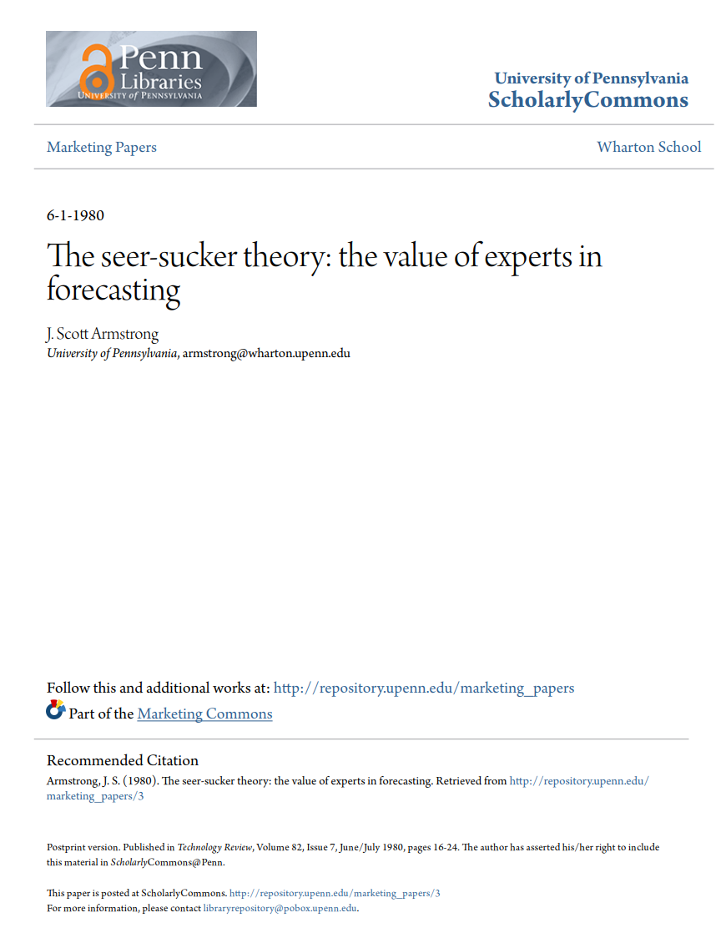
Seer-sucker Theory of Forecasting
"No matter how much evidence exists that seers do not exist, suckers will pay for the existence of seers."
(Scott Armstrong, 1980)

Slide 13
The path towards change
Forecasting
Scenarios
Backcasting
Predict most
likely future
Explore alternative futures
Assess feasibility of desirable future
Future
Future
Future
Present
Present
Present

Slide 14
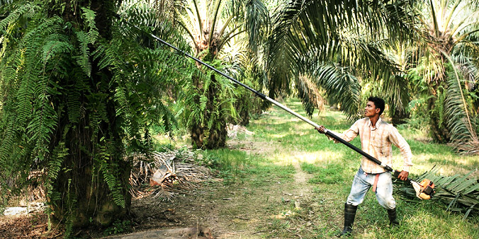
The consequences of waiving palm oil
Commercially available alternatives to palm oil (Hinrichsen, 2016)
Partially hydrogenated fats
Fully hydrogenated fats
Exotic fats
Liquid oils
Economic development and poverty alleviation
Source: Economic Transformation Programmel
Notes:
Study available at: http://onlinelibrary.wiley.com/doi/10.1002/lite.201600018/full (3 pages)
Partially hydrogenated fats:
Due to the fact that partially hydrogenated oils can contain a significant amount of trans-fatty acids, which are considered as unhealthy, their use and application has steadily decreased since the mid-90's → usage is almost eliminated in Western Europe and therefore not a viable option (palm oil was the solution to this issue) → since several years there has been a demand for food products free of palm oil
Fully hydrogenated fats
Benefits: During the hydrogenation process and at full hydrogenation, a fat does not contain either unsaturated fatty acids or trans-fatty acids in any significant quantity
Issue: Most fully hydrogenated fats typically have a melting point above 50 degrees Celcius → high “solid fat content” at body temperature and therefore an unpleasant sensory experience
Solution: To achieve a melting profile that is appropriate for most food applications (almost liquid at body temperature plus functionality at lower temperatures), a fully hydrogenated oil can be blended and interesterified with various non-hydrogenated oils to produce a functional and organoleptically acceptable end-product → by blending liquid oils such as rape, sunflower, soya, etc. with fully-hydrogenated oil(s), a good baking fat blend can be achieved
Alternative: Blend the hydrogenated liquid oil with a lauric fat, such as coconut oil → using coconut oil in combination with fully hydrogenated oils will produce a much steeper melting profile and a higher solid fat content at 10 and 20°C → due to the steep melting profiles and pleasant meltdown at body temperature, such blends can give very good results in confectionary fillings
However as coconut oil and fully hydrogenated liquid oils both have a very high level of saturated fatty acids, the blend will be significantly higher in saturates than palm oil and therefore may be an issue for some customers and/or consumers (health concerns, e.g. cardiovascular diseases, cancer, bone health in terms of mineral density)
Therefore, even though the mentioned fully hydrogenated fats do not contain trans-fatty acids, in many countries it is still necessary to label the process of hydrogenation on the food packaging, although the EU commission is reviewing this as part of potential “trans” legislation. If a food should be labeled as “non-hydrogenated” and “palm oil free”, fat blends based on exotic fats, might therefore be a better solution.
Exotic fats:
“Exotic fats” are typically fats such as shea, sal, illipé, kokum and mango kernel, in addition there are many other “exotic fats”, but these are not available in significant volumes
They all have in common a relatively high level of symmetrical triglycerides → need special tempering to crystallize into the desired stable form
Example used in article: By blending liquid oils with shea stearin, fat blends can be produced that replace palm mid fractions, for example as a filling fat in confectionary applications. Still, to achieve the required stable crystal configuration, it is necessary to temper the filling, similar to chocolate. Especially at room temperature (ca. 20°C), a non-tempered fat with a high level of symmetrical triglycerides will often be too soft. Also it will tend to recrystallize during storage and can cause fat bloom. A slight amendment of the recipe and processing conditions might still be necessary, as these blends will not have exactly the same melting profile as palm mid fractions
Benefits: Because of their high level of liquid oils, such blends will mostly have a level of saturated fatty acids, lower than the originally used palm mid fraction → in the described example, the non-palm fat has a level of saturated fatty acids of 41% compared to a level of 59% in a palm mid fraction
Issue: Blending exotic fats with liquid oils therefore can be a good solution to replace palm-oil-based fats in some confectionary applications when equipment to temper the product is available → in many cases though, the production lines are not equipped with tempering equipment and an upgrade would be costly
Issue: One of the major drawbacks of non-palm and non-hydro fats based on shea, cocoa butter or other exotic fats is the high price of the raw materials → even though in most cases a specialty fat is not composed exclusively from exotic fats, a replacement by a non-palm solution is significantly more expensive than a palm based product, for the same performance
Liquid oils:
General: A very obvious way to replace palm oil would be the usage of liquid oils like rapeseed oil, sunflower oil or soy bean oil → however, due to their liquid aggregate state, they cannot replace all sorts of palm fractions in every application → still, in applications where only small volumes of fat are used (for example bread, wafers, release agents) or where liquid fractions of palm oil (oleins) are applied, a replacement of palm by liquid oils is often possible
Benefit: Most liquid oils have a significant lower level of saturated fatty acids and a higher level of polyunsaturated fatty acids than palm oil → positive reputation in respect of health
Issue: However, lower stability in terms of oxidative degradation → conventional rapeseed oil and sunflower oil have a high level of polyunsaturated fatty acids, and therefore oxidize relatively quickly in the frying process → from the oxidation, breakdown products arise (compounds like aldehydes) → can even be regarded as unhealthy
Therefore, the appropriate alternative to palm could be high oleic sunflower and high oleic rapeseed oil, as they have high levels of monounsaturated fatty acids and a rancimat stability index only slightly lower than palm oil or palm olein, due to their elevated levels of oleic acid and reduced levels of both linoleic and linolenic acid
Conclusion:
As discussed, it may be possible to replace palm oil by liquid oils, blends with exotic fats, or blends with fully hydrogenated liquid oils → this will cause some technological challenges, but these are not necessarily insurmountable
But the question remains whether the exclusion of palm oil is actually fully viable or a necessary step → fats like coconut oil or cocoa butter, which have a perceived health advantage over palm oil, actually have a similar or even higher level of saturated fatty acids → also, sustainable palm oil is already commercially available and efforts are undertaken to improve further palm oil sustainability
Finally, palm oil is a much more efficient land use compared to other vegetable oils → the issues related to an expansion of other types could potentially be much worse → also, since palm oil is cheaper, it is important to consider whether consumers are willing to pay an increased price
Although there may be commercially available alternatives to palm oil, it is important to consider that the palm oil industry is a significant contributor to economic development for the producing countries, where it provides employment for millions of people and helps to alleviate poverty → in this way, the waiving of products containing palm oil could have severe consequences for the livelihood of a large number of people

Slide 15
Thank You
Source: Kevron Global

